Slide 1


Pandemic Excess Deaths using forecasting methods
Nuria Diaz-Tena
Collaborators:
Davit Sargsyan, Javier Cabrera, Michael Katehakis, Jingyu Cai, Dhammika Amaratunga, Ana Altunya, I-Ming Chiu, Yajie Duan, Chun Pang Lin, Jin Wan & The Rutgers COVID Analytics Research Group

Slide 2
How did the COVID Pandemic affect the US?
Background of Deaths in the US
By state
By cause of death
Definition of Excess Death
Forecasting Methods
Excess deaths compared to COVID deaths over time
Major causes of death affected by COVID-19
Adding an additional dimension to the data set for forecasting
States more affected by COVID-19
Data Sources:
CDC Mortality data for US (from 2010 data July 2022)

Slide 3
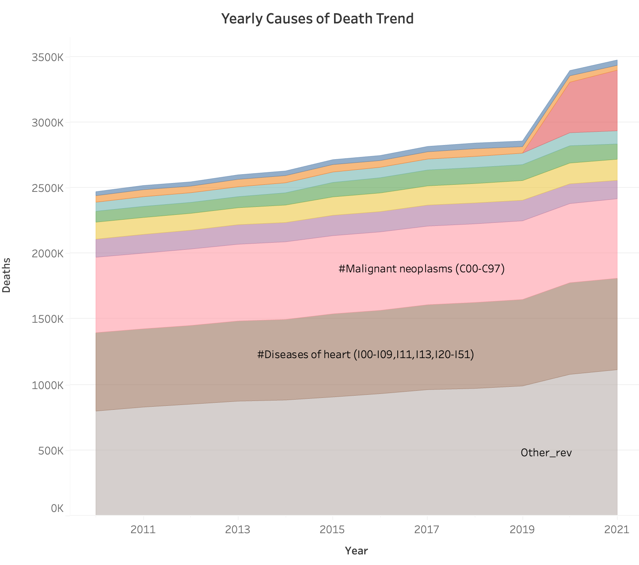
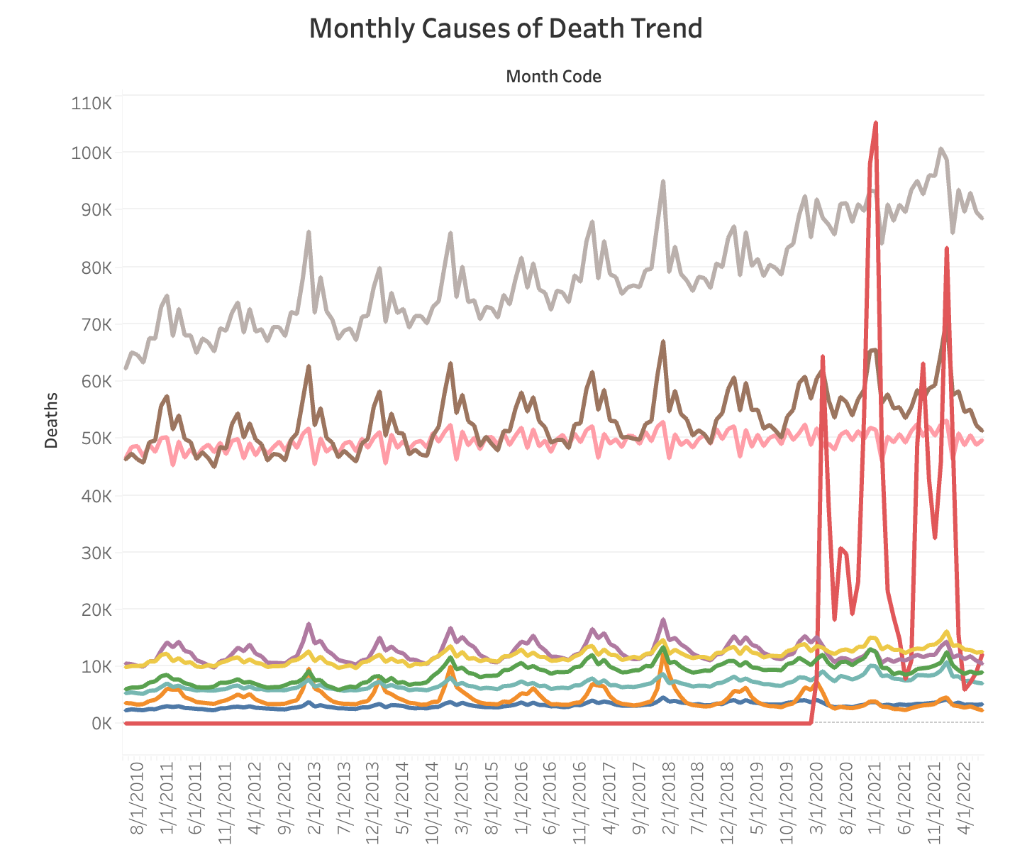
Yearly death increased between 1% to 3% before COVID-19. It increased 19% in 2020
The major causes of death are diseases of the heart and cancer.
COVID-19 was the third cause of death in 2020
Other diseases respiratory system
COVID-19
Influenza
Diabetis
Alzeimer
Cerebrovascular
Chronic Lower Respiratory

Slide 4
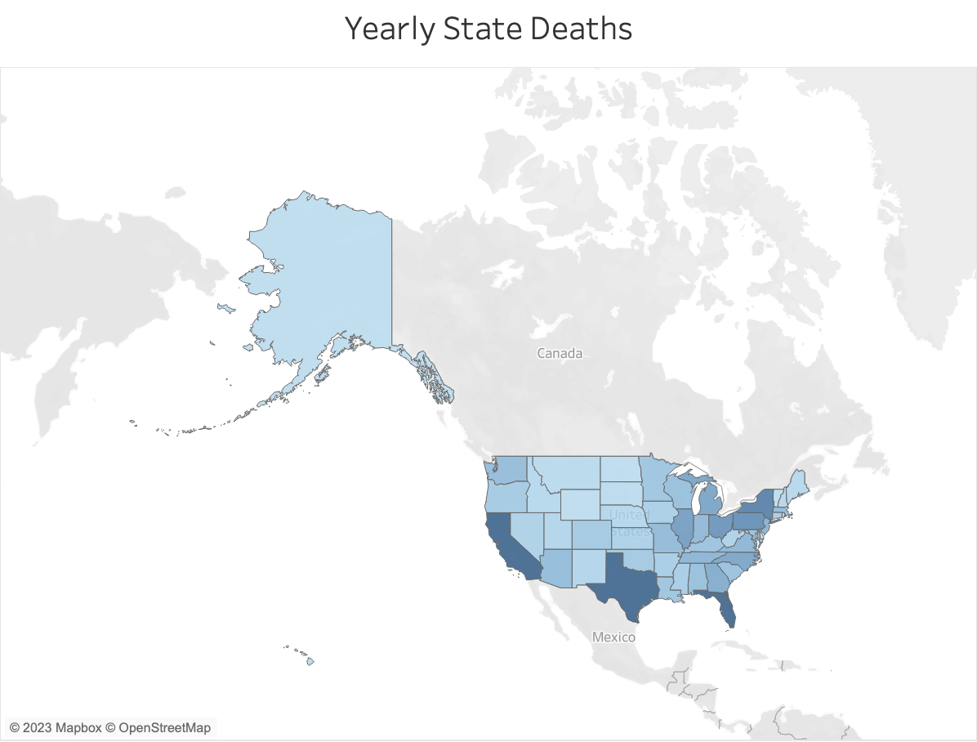
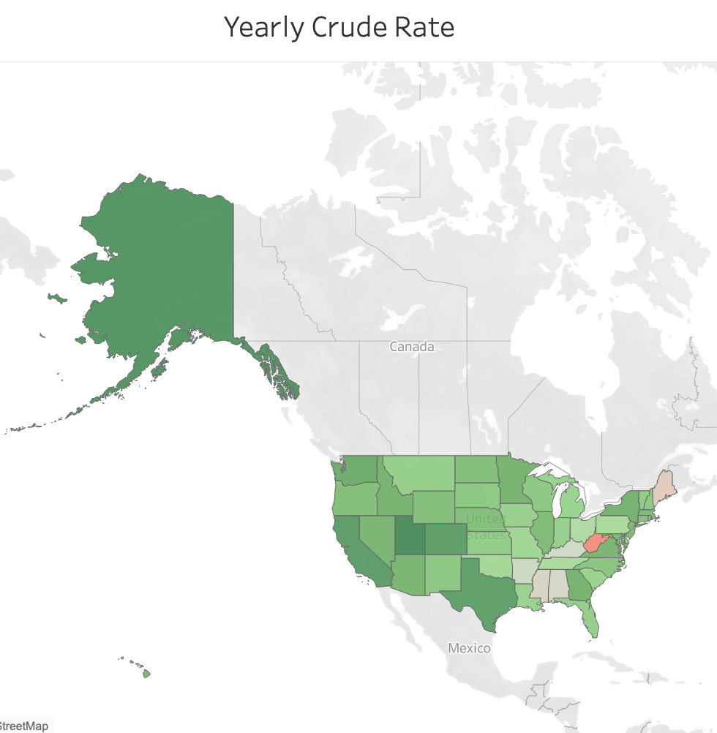
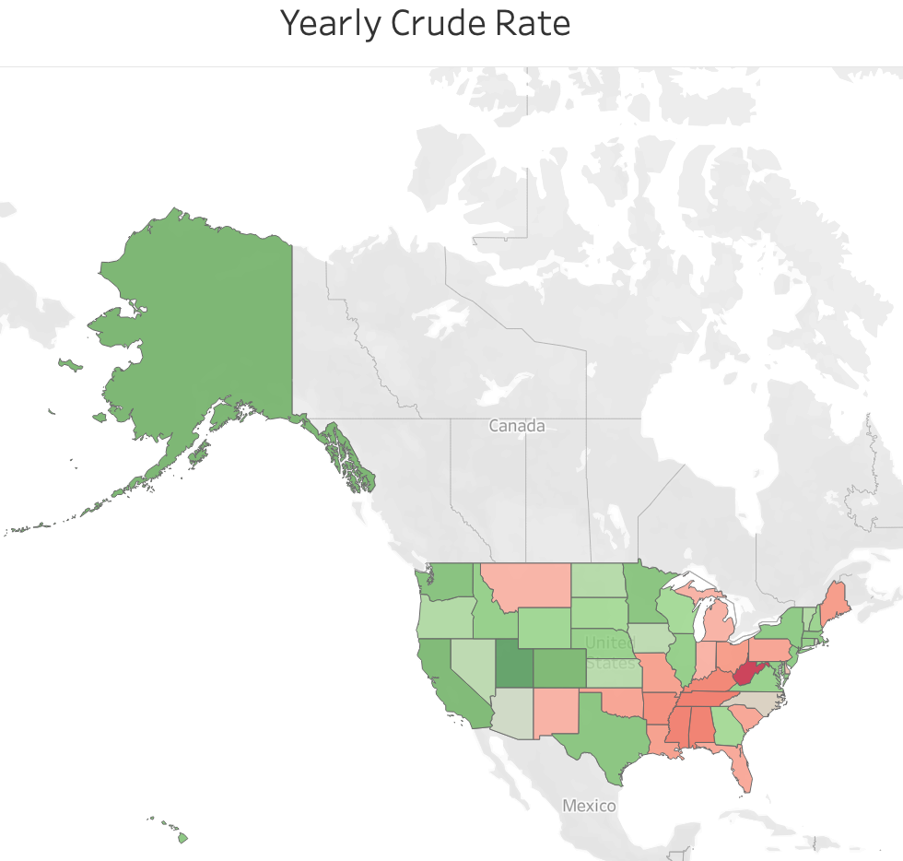
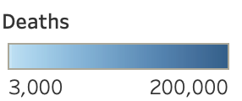
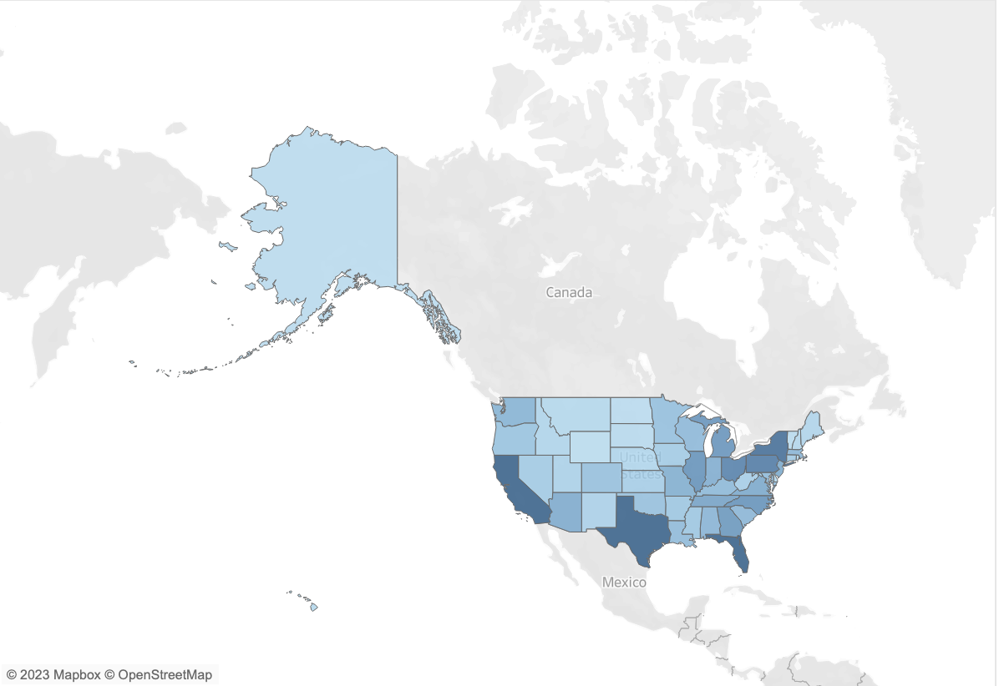
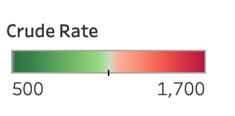
West Virginia, Maine, Mississippi, Alabama, Kentucky, Tennessee and Arkansas are the states with the largest Crude rate in 2019
West Virginia had a crude rate in 2019 of 136. It increased to 1619 in 2021
California, Texas and Florida are the states with the largest yearly deaths – because they are the most populous states
Year 2019
Year 2019
Year 2021
Year 2021
Crude Rate = 100,000* Deaths/Population

Slide 5
What are excess deaths?
COVID-19 Excess Deaths = Total Deaths – Forecasted deaths excluding COVID
Number of Deaths
Reported COVID deaths
Excess deaths
Actual No COVID deaths
Forecast deaths excluding COVID
2016 2017 2018 2019 2020 2021

Slide 6
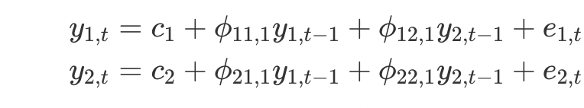
Spatial Time Series Forecasting Methods
Spatial Time Series Forecasting
Spatial Forecast Exponential Smoothing
VAR MODEL (Vector Autoregressive Models) A VAR model is a generalization of the univariate autoregressive model for forecasting a vector of time series. It comprises one equation per variable in the system. The right-hand side of each equation includes a constant and lags of all of the variables in the system.
VARIMA (Vector Autoregressive Integrated Moving Average) Model
GSTAR-SUR Generalized Space Time Autoregressive with Seasonal
FFNN-VAR Feedforward Neural Network – Vector Autoregressive
FFNN-GSTAR Feedforward Neural Network - Generalized Space-Time Autoregressive
Bootstrapping Time series
Dynamic harmonic regression (Fourier terms) TBATS model (combination of Exponential smoothing and Fourier terms – more flexible to recent changes due to ES weighting scheme)
….
2-dimensional VAR(1)

Slide 7
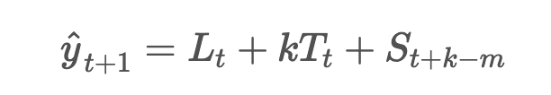
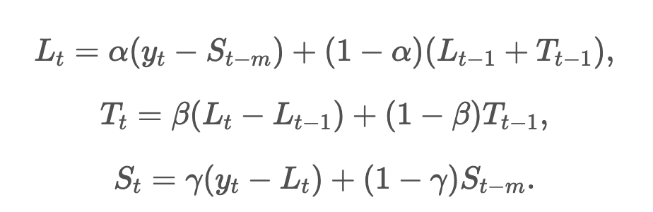
Monthly Exponential Smoothing used at the state and cause of death level
Exponential smoothing state space model with Box-Cox transformation, ARMA errors, Trend and Seasonal components
Level Trend Season
t – time in months
Forecasts for each state and cause of death

Slide 8
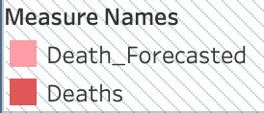
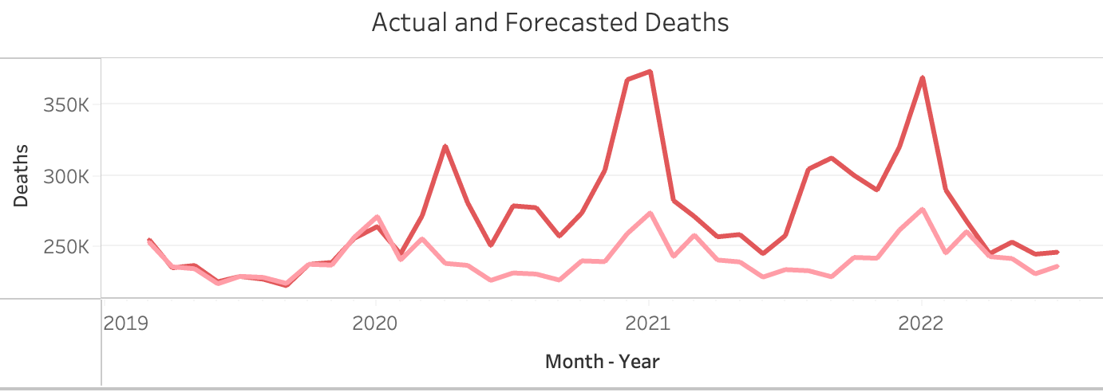
Overall Forecast
Monthly Historical data from 2010 till 2019 February was used to train the model. The forecast starts in 2019 March. The actual deaths and the forecasted are very close during the first year of the forecast (prior to COVID-19). The Actual is larger than the forecasted starting in 2020 March

Slide 9
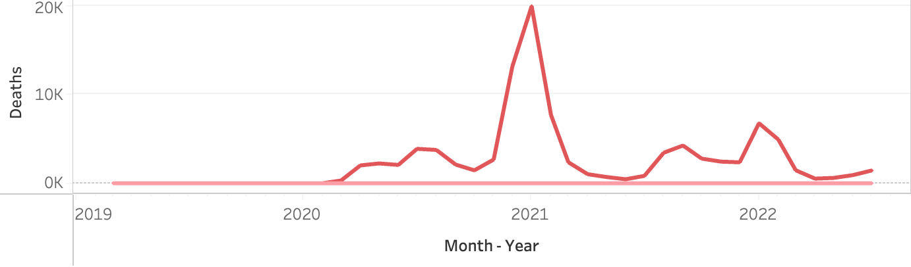
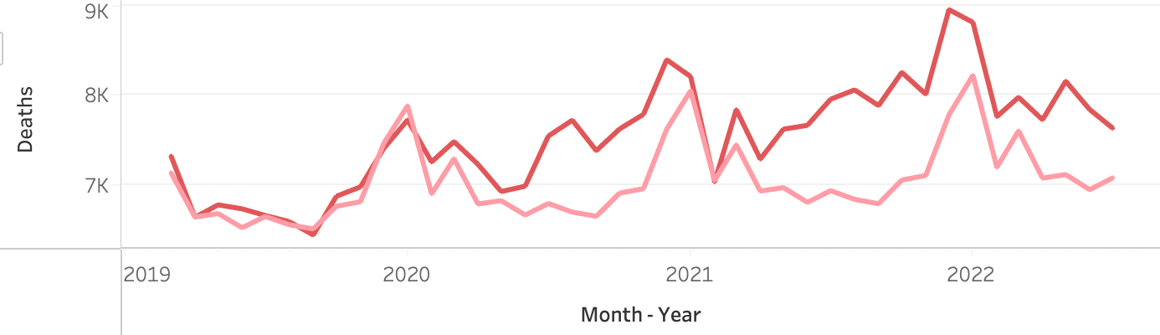
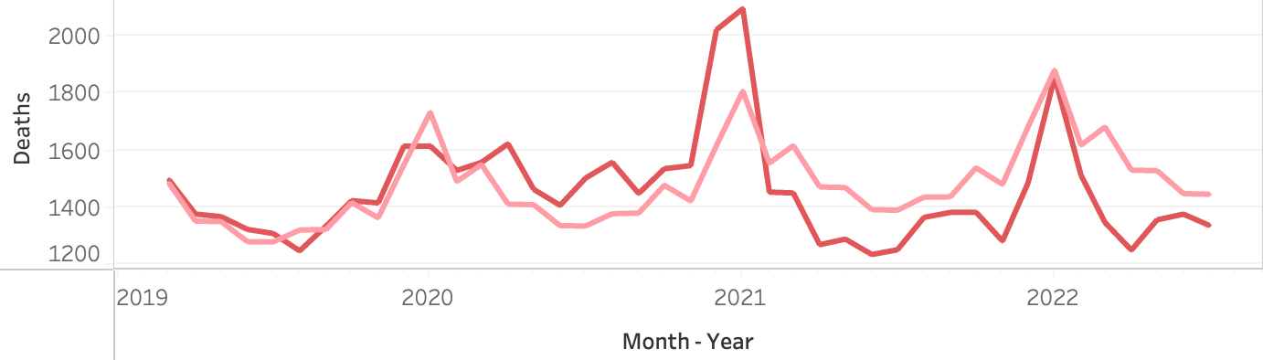
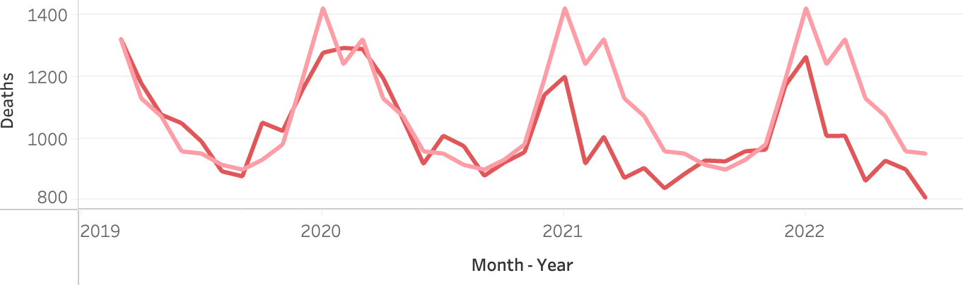
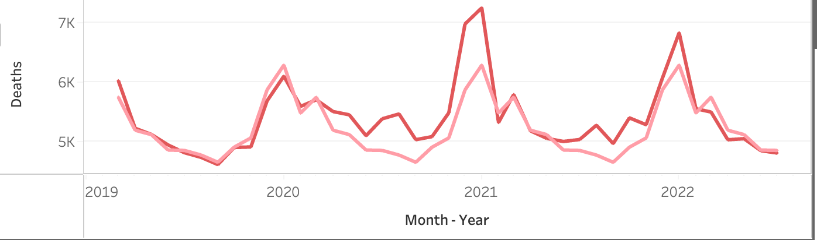
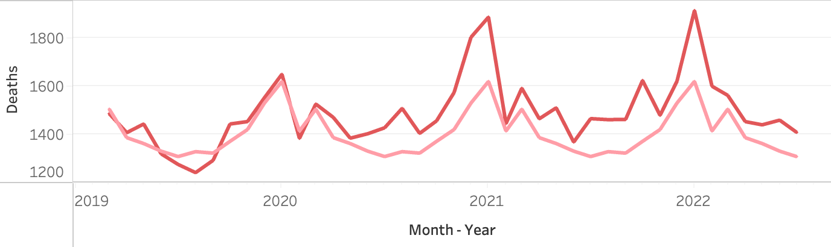
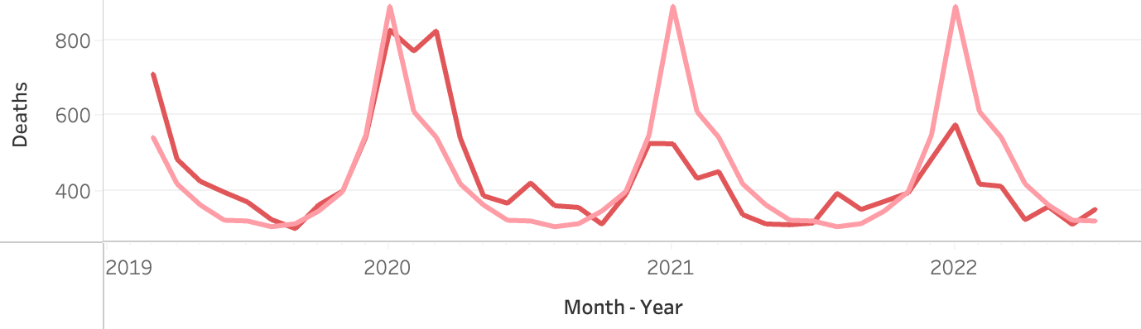
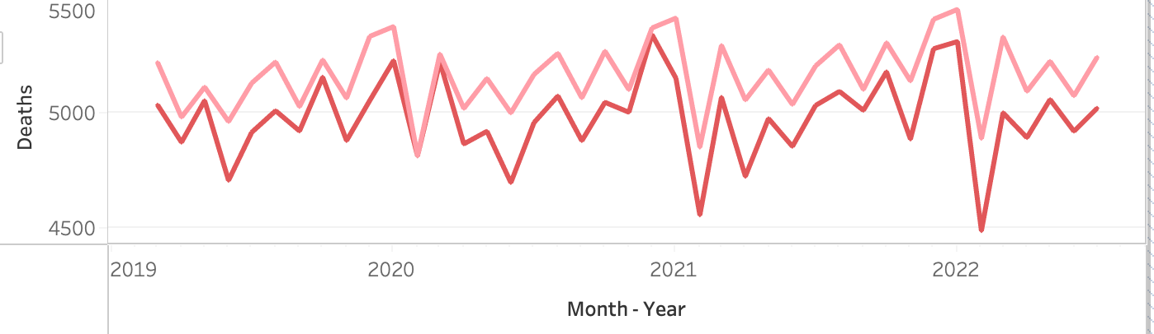
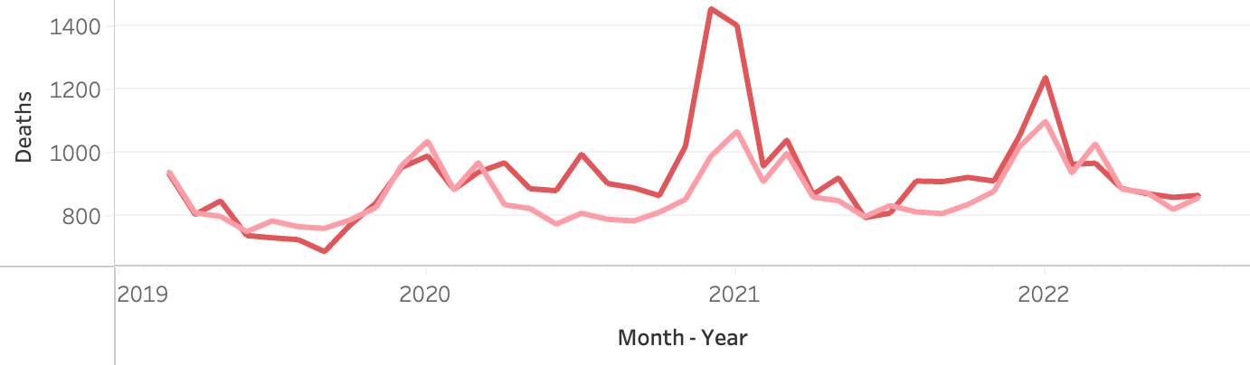
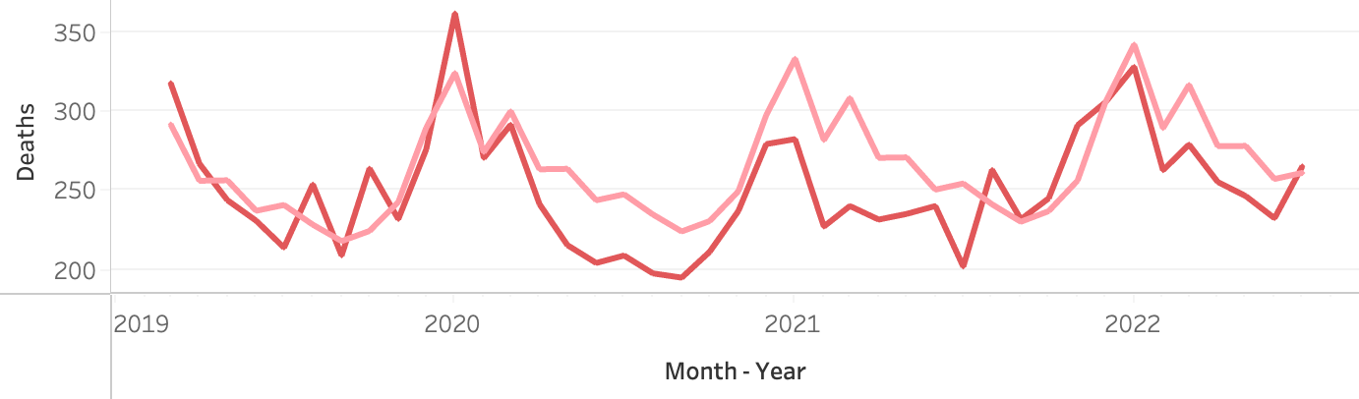
California Forecast
COVID-19 – Excess Deaths
The Cancer forecast is overestimated
The other diseases are on target on the year prior to COVID.
The forecast after COVID-19 is larger than the actual (Reduced Deaths) or smaller than the actual (Excess Deaths)
Other – Excess Deaths
Alzheimer’s – Mixture of Excess Deaths and Reduced Deaths
Chronic Lower Respiratory – Reduced Deaths
Diseases of the Heart – Mixture of Excess Deaths and Reduced Deaths
Cerebrovascular – Excess Deaths
Influenza and Pneumonia – Reduced Deaths
Cancer – Overestimated
Diabetes – Excess Deaths
Other diseases Respiratory system – Reduced Deaths

Slide 10
Misclassified COVID deaths have decreased over time
New protocols and tests had to be introduced as a consequence of COVID-19 -a new disease that become the 3rd cause in 2020 in the US. We were expecting misclassification cases
The misclassified cases dropped over time
Year | COVID Deaths | Excess Deaths | Pct unaccounted
2020 | 385,072 | 497,157 | 29%
2021 | 462,197 | 546,012 | 18%
2022 till July | 182,195 | 181,581 | 0%
Till July 2022 | 1,030,264 | 1,224,750 | 19%
Data at Year, Month, Cause of death level
Prediction model
Data collected till July 2022

Slide 11
Data processing and subsetting
DeathDaily = Death/daymonth (i.e., average daily death = average monthly death/number of days in that month)
Removed records: Date >= 2022-07-01
Removed states with max(DeathDaily) <10 in Cerebrovascular diseases (I60-I69). 20 out of 51 states left.
Divided data into training (before 2019/03/01), testing (2019/03/01 to 2020/02/28 or 29) and Covid-19 (2020/03/01 to 2022/06/01)
Calculated Rate (no more zeros) = 10^5*(Deaths/(daymonth*Population)
NOTE: if there were zeros then Rate = 10^5*(Deaths + 1)/(daymonth*(Population + 1))

Slide 12
Population dynamics (% Jan 2010) in the US 51 states between Jan 2010 and June 2022

Slide 13
Only the states that reached at least 10 CVD deaths daily were kept in the analysis

Slide 15
Nonlinear Mixed-Effects Model
Rate ~ b0 + b1*dt + b2*dt^2 + b3*sin(b4 + b5*dt) | State
where b0: y-intersept; b1: linear trend; b2: quadratic term; b3: wave magnitude; b4: wave offset left; b5: wavelength.
Cause of death | b0 | b1 | b2 | b3 | b4 | b5
Alzheimer disease (G30) | 0.4277 | -5.40E-05 | 2.04E-09 | 0.0119 | 15.14 | 0.0171
Cerebrovascular diseases (I60-I69) | 0.4727 | -4.78E-05 | 1.61E-09 | 0.0107 | 14.67 | 0.0172
Chronic lower respiratory diseases (J40-J47) | -0.1350 | 2.89E-05 | -7.55E-10 | 0.0226 | 13.80 | 0.0172
Diabetes mellitus (E10-E14) | 0.0154 | 3.97E-06 | -4.42E-11 | 0.0070 | 13.43 | 0.0172
Diseases of heart (I00-I09,I11,I13,I20-I51) | 1.1233 | -7.92E-05 | 2.72E-09 | 0.0547 | 14.26 | 0.0172
Influenza and pneumonia (J09-J18) | -0.3035 | 4.26E-05 | -1.29E-09 | 0.0170 | 14.89 | 0.0171
Malignant neoplasms (C00-C97) | 0.1835 | 4.27E-05 | -1.34E-09 | 0.0096 | 14.47 | 0.0172
Other_rev | 0.1453 | 3.95E-05 | -2.92E-13 | 0.0501 | 14.64 | 0.0172
Other diseases of respiratory system (J00-J06,J30- J39,J67,J70-J98) | 0.0644 | -7.29E-06 | 3.33E-10 | 0.0043 | 14.42 | 0.0172

Slide 16
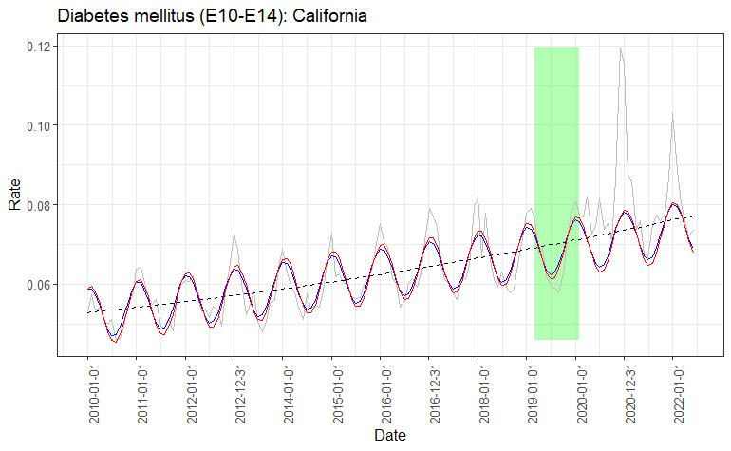
Model Fits Example: Diabetes in CA
Grey curve: observed daily death rate
Black dashed curve: LM prediction (with quadratic term)
Blue curve: NLME prediction using all states
Red curve: NLS prediction using only CA data

Slide 17
Nonlinear Mixed-Effects Model Mean Absolute Percent Error
MAPE = 100*mean(abs(Rate - prd3)/(Rate)))
Cause of Death | Training | Testing | COVID-19
Alzheimer disease (G30) | 8.65 | 14.21 | 28.05
COVID-19 (U07.1) | 6.64 | 7.38 | 14.91
Cerebrovascular diseases (I60-I69) | 5.06 | 5.39 | 5.99
Chronic lower respiratory diseases (J40-J47) | 6.11 | 5.85 | 14.80
Diabetes mellitus (E10-E14) | 3.11 | 2.93 | 6.20
Diseases of heart (I00-I09,I11,I13,I20-I51) | 15.66 | 14.61 | 39.57
Influenza and pneumonia (J09-J18) | 2.16 | 2.12 | 3.01
Malignant neoplasms (C00-C97) | 2.80 | 2.43 | 7.66
Other diseases of respiratory system (J00-J06,J30- J39,J67,J70-J98) | 8.65 | 14.21 | 28.05
Other_rev | 9.39 | 10.91 | Inf

Slide 18
Nonlinear Mixed-Effects Model Predicted Death
Deaths_prd := prd3*daysmonth*Population*10^(-5)
Excess Death (% predicted) = 100*sum(Deaths - Deaths_prd)/sum(Deaths_prd)
Cause of Death | Training | Testing | COVID-19
Alzheimer disease (G30) | 8.65 | 14.21 | 28.05
COVID-19 (U07.1) | 6.64 | 7.38 | 14.91
Cerebrovascular diseases (I60-I69) | 5.06 | 5.39 | 5.99
Chronic lower respiratory diseases (J40-J47) | 6.11 | 5.85 | 14.80
Diabetes mellitus (E10-E14) | 3.11 | 2.93 | 6.20
Diseases of heart (I00-I09,I11,I13,I20-I51) | 15.66 | 14.61 | 39.57
Influenza and pneumonia (J09-J18) | 2.16 | 2.12 | 3.01
Malignant neoplasms (C00-C97) | 2.80 | 2.43 | 7.66
Other diseases of respiratory system (J00-J06,J30- J39,J67,J70-J98) | 8.65 | 14.21 | 28.05
Other_rev | 9.39 | 10.91 | Inf

Slide 19
State | Observed Death During the Testing Months (2019/03/01 to 2020/02/28, % Predicted)
 | Alzheimer disease (G30) | Cerebrovascular diseases (I60-I69) | Chronic lower respiratory diseases (J40-J47) | Diabetes mellitus (E10-E14) | Diseases of heart (I00-I09,I11,I13,I20-I51) | Influenza and pneumonia (J09-J18) | Malignant neoplasms (C00-C97) | Other_rev | Other diseases of respiratory system (J00-J06,J30- J39,J67,J70-J98)
Alabama | -11.1 | 1.0 | -4.3 | 7.7 | -1.6 | -1.7 | -2.3 | 1.1 | -11.8
Arizona | -9.8 | -4.6 | -10.0 | -2.5 | -0.3 | 11.9 | 0.9 | 0.3 | -7.8
California | -6.3 | -2.0 | -0.7 | -0.8 | -1.1 | -2.0 | 0.2 | 2.1 | -0.1
Florida | -19.3 | -0.4 | -3.6 | -0.2 | -1.2 | 3.2 | 0.3 | 0.2 | 0.0
Georgia | -16.9 | -6.6 | -6.8 | -2.4 | 1.5 | -1.7 | 0.8 | 3.0 | -9.8
Illinois | -11.1 | -0.1 | -1.6 | -4.1 | -1.4 | -3.2 | -0.5 | -1.2 | -12.3
Indiana | -13.2 | 5.2 | 2.1 | -6.3 | -0.6 | -3.6 | 1.0 | -1.0 | -1.1
Maryland | -20.7 | 1.0 | 3.7 | 2.8 | -0.1 | -10.6 | -0.8 | -2.5 | -7.6
Michigan | -9.8 | -0.1 | 2.4 | 5.7 | -2.6 | 2.4 | 0.6 | -0.2 | 2.8
Missouri | 3.3 | -3.8 | -5.5 | 1.5 | -1.2 | -12.2 | -0.7 | -1.9 | 6.6
New Jersey | -14.0 | 0.7 | -3.1 | 7.4 | -2.5 | 0.8 | -0.5 | -0.2 | 5.0
New York | -7.4 | -3.5 | 2.6 | 5.5 | -1.9 | 0.6 | 0.0 | 1.3 | 11.0
North Carolina | -8.5 | -2.9 | -3.8 | -4.2 | -0.5 | -7.5 | 0.0 | -0.1 | -8.6
Ohio | -8.8 | -0.5 | -0.9 | 1.4 | -0.1 | -10.0 | -0.9 | -2.0 | -9.1
Pennsylvania | -9.6 | -0.4 | -1.9 | -2.1 | -2.7 | -6.2 | 0.5 | -1.7 | -3.3
South Carolina | -22.4 | -8.6 | -7.1 | 2.4 | -2.6 | -6.7 | -0.8 | 0.5 | 13.4
Tennessee | -14.9 | -2.7 | -3.2 | 10.4 | 1.5 | -8.2 | -0.5 | 2.1 | 12.9
Texas | -11.6 | -7.4 | 0.3 | 11.3 | -2.2 | 5.6 | 2.2 | 2.2 | -10.7
Virginia | -5.8 | 1.5 | 9.1 | 4.0 | 0.6 | -9.3 | 0.5 | 0.7 | 1.5
Washington | -9.3 | -4.5 | -2.8 | -1.3 | 0.4 | 2.0 | 0.0 | 1.9 | 0.2

Slide 20
State | Observed Death During COVID-19 (2020/03/01 to 2022/06/01, % Predicted)
 | Alzheimer disease (G30) | Cerebrovascular diseases (I60-I69) | Chronic lower respiratory diseases (J40-J47) | Diabetes mellitus (E10-E14) | Diseases of heart (I00-I09,I11,I13,I20-I51) | Influenza and pneumonia (J09-J18) | Malignant neoplasms (C00-C97) | Other_rev | Other diseases of respiratory system (J00-J06,J30- J39,J67,J70-J98)
Alabama | -16.4 | -4.1 | -15.1 | 44.9 | 4.6 | -10.3 | -2.4 | 7.9 | -10.8
Arizona | -22.3 | -1.8 | -15.9 | 5.3 | 7.8 | 11.9 | 1.6 | 12.6 | -8.5
California | -11.1 | 0.2 | -7.0 | 12.7 | 2.9 | -11.6 | 2.5 | 14.3 | -12.5
Florida | -25.0 | -0.2 | -13.0 | 21.2 | 1.4 | 12.6 | 2.0 | 6.8 | -12.4
Georgia | -24.4 | -4.0 | -11.8 | 14.1 | 7.1 | 5.5 | 1.3 | 14.4 | -6.5
Illinois | -13.9 | 1.2 | -10.2 | 13.7 | 0.0 | -11.5 | -1.5 | -1.0 | -19.5
Indiana | -26.0 | 3.0 | -5.8 | 11.3 | 0.5 | -16.3 | 1.9 | 2.5 | -6.7
Maryland | -19.7 | -1.2 | -6.8 | 18.5 | 1.7 | -30.2 | -1.4 | -5.0 | -36.2
Michigan | -19.6 | 2.2 | -10.6 | 23.1 | -0.9 | -8.9 | 1.0 | 3.2 | -9.6
Missouri | -11.5 | 3.1 | -8.4 | 13.9 | 3.2 | -16.4 | 3.8 | 3.9 | -3.6
New Jersey | -24.4 | 1.2 | -11.3 | 32.4 | -2.5 | 11.8 | -1.0 | -4.9 | 13.9
New York | -22.7 | -0.8 | -9.9 | 15.9 | 0.4 | -0.4 | -0.2 | 5.2 | 7.1
North Carolina | -21.6 | -1.4 | -16.0 | 10.3 | 3.5 | -22.7 | 0.0 | 5.8 | -13.2
Ohio | -13.3 | 3.3 | -10.3 | 17.5 | 1.3 | -17.0 | -1.2 | -2.0 | -10.1
Pennsylvania | -12.0 | 0.1 | -10.6 | 14.1 | -3.4 | -21.7 | 1.2 | -1.1 | -12.4
South Carolina | -27.4 | -4.9 | -14.4 | 4.5 | 2.8 | -33.1 | -2.8 | 5.1 | 5.7
Tennessee | -24.2 | 8.2 | -10.8 | 33.7 | 9.6 | -11.5 | 2.0 | 14.0 | 13.3
Texas | -16.6 | -2.6 | -6.6 | 28.3 | 2.8 | 10.7 | 4.2 | 14.1 | -15.0
Virginia | -17.6 | 3.0 | -5.6 | 9.6 | 5.0 | -13.6 | 1.9 | 7.9 | -8.5
Washington | -14.3 | -5.7 | -7.3 | 15.9 | 4.8 | -46.2 | 3.2 | 13.5 | -9.7

Slide 21
PCA on observed daily death (as % of predicted)
Influenza death were higher than predicted in TX, FL, AZ, GE and NJ
Diabetes deaths exceeded the predicted the most in NJ, NY and TN

Slide 22
Population dynamics (% Jan 2010) in the US 51 states between Jan 2010 and June 2022
Error bars indicate 95% CI calculated on the Testing data
Green dots are the observed deaths as % of predicated, by State
The model underestimated deaths from Alzheimer even during the Testing years
During COVID-19 years, the predicted death caused by Alzheimer, Chronic Lower Respiratory and Influenza were much lower that expected from the Testing set, while Diabetes death was much higher than expected

Slide 23
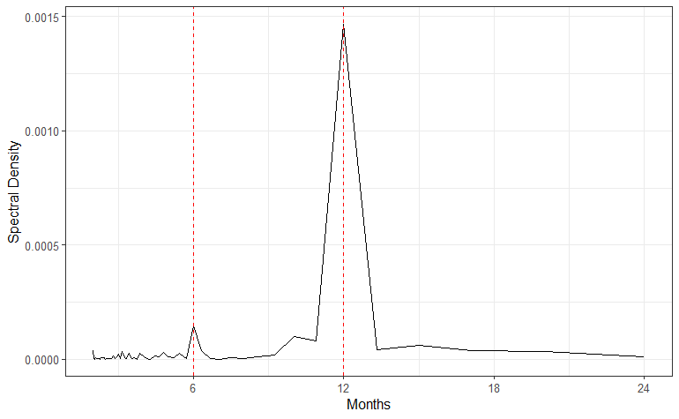
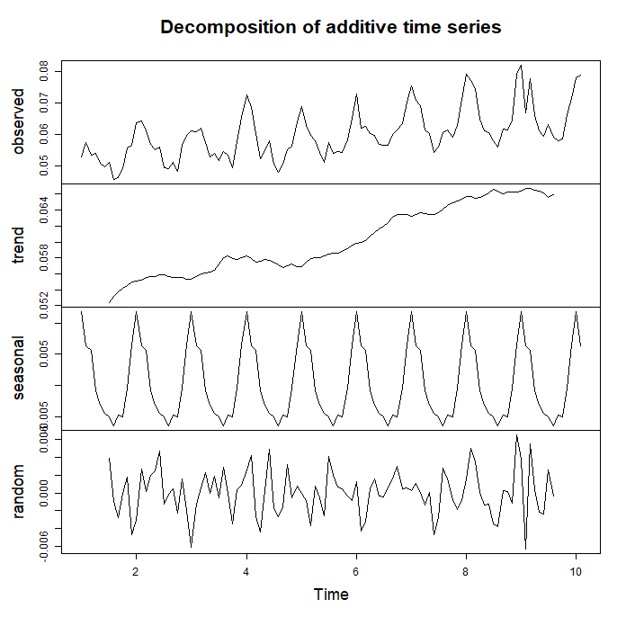
Classical Seasonal Decomposition by Moving Averages (Diabetes in CA Example)
Spectral density analysis of the time series confirmed periodicity of 12 months (R::spectrum)
Increasing trend and seasonality captured (R::decompose), with Random component being an order of magnitude smaller than the Seasonal component

Slide 24
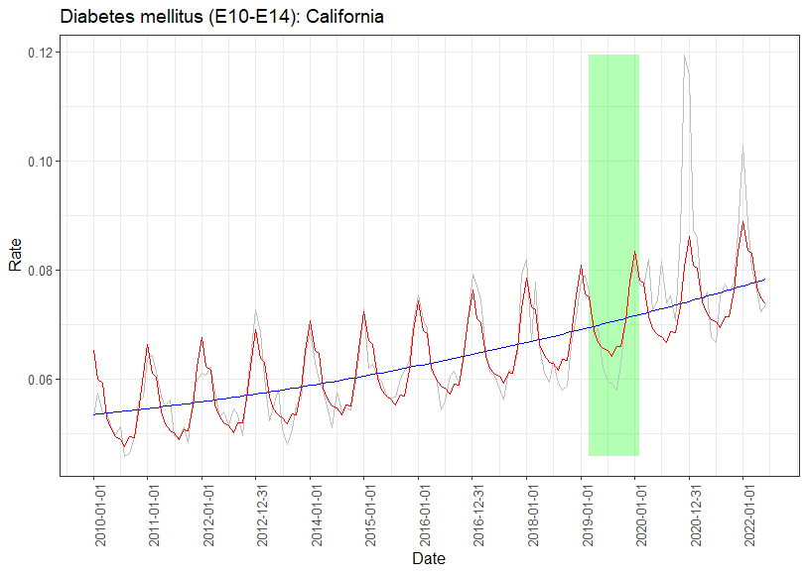
Classical Seasonal Decomposition by Moving Averages (Diabetes in CA Example)
Set | NLME MAPE | CSD MAPE
Training | 4.75 | 3.98
Testing | 5.03 | 4.41
COVID-19 | 10.00 | 8.00

Slide 25
THANKS
Any Questions?

